Slide 1

Parking lots automatization application

Slide 2
Planning

Slide 3
TABLE OF CONTENTS
01
Project Proposal
05
Workplan
02
System Request
06
Staff
03
Feasibility Study
07
Our Team
04
Methodology

Slide 4
Project Proposal
Description
Scope
Aim
PARK IT is a AI smart parking app. Designed for a local parking lot company. The company has 5 parking lots and they want to make their parking lots profitable. With PARK IT, they will increase their density of parking lots and they will advertise their all lots too.
With Park It, users will be able to check in/out to the parking lots with QR code system, monitor live density information of the parking lots, see their previous payment details and
We have two main aim. Firstly, mainge profitable of companies all parking lots. Two of them have great density but other 3 of parking lots are not profitable for company. Secondly, according to survey we did with customers, we should increase customer satisfaction.

Slide 5
System Request
Project Sponsor
Business Need
Project Requirements
The managers of the parking lot company.
This project has been initiated to create a system which allows them to keep track of the density of their parking lots, keep track of payments which include monthly memberships
Check the nearest available parking lots which the company has.
Check in and check out the parking lot with a QR code system.
Easy payment with an online payment system.
Keep track of their payments.
Establish a customer subscription into the parking lot for a monthly fee.

Slide 6
System Request
BUSINESS VALUE
PARKING LOT | CAPACITY | DENSITY % | DAILY PRICE FOR NON MEMBERS | NON MEMBER PRICE (DAILY) | DENSITY (CAR) | MEMBERSHIP RATE % | MEMBERSHIP (CAR) | MEMBERSHIP PRICE
#1 | 100 | %90 | 54 | $30 | 90 | %40 | 36 | $300
#2 | 200 | %60 | 84 | $25 | 120 | %30 | 36 | $250
#3 | 300 | %30 | 81 | $20 | 90 | %10 | 9 | $200
#4 | 300 | %20 | 54 | $15 | 60 | %10 | 6 | $250
#5 | 400 | %15 | 57 | $10 | 60 | %5 | 3 | $150
Density is calculated by daily occupancy of parking lots. Total parking lot capacity of the company is 1300 however density of occupancy is 420(%32,307). Total membership is very low overall. Company has 90 members and it is %6,923. Our first goal is directing customers to empty parking lots. Thanks to app customers and members realize our other lots and park their car to our all parking lots. Our expectation is to increase members to around %30 of our total capacity. We will increase our members to 390 from 90. Our decided membership price for the Park It app is $250. Now from members, the company earns $23.100 per month. From our expectation, income from members increased around %422 ($97.500) per month. We believe that we can reach our goal within 6 month after releasing the Park It app. Daily income from non-members is $6720 per day. Our decided non-membership price per day for the Park It app is $20. Our expectation is for non-member occupancy up to %40 from %25,384. Our income will increase to $10.399 (%154,761). We will add loyalty awards for our customers such as Diamond membership (priority for parking), discounts etc. These will prevent our members from going to our opponents.

Slide 7
Feasibility Study
Technical Feasibility
Main technologies and tools:
Flutter
Dart
Firebase
Figma
Diagram drawing tools:
Microsoft Project
Draw.io
Initially, we will be developing our system with a free hosting server with firebase, but for later implementations, it will be hosted on a paid server with sufficient bandwidth.
Bandwidth required in this application is very low, since it does not incorporate any multimedia aspect.
Each of the technologies are freely available and the technical skills required are manageable.

Slide 8
Feasibility Study
Economic Feasibility
COSTS:
125 USD Dev Accounts
20 USD Server Cost
5000 USD DEVELOPERS
400 USD ANNUAL TECHNICAL SUPPORT
13.000-16.900 USD INFRASTRUCTURE COST
INCOMES:
STEADY MONEY FLOW
PREVENT MONEY FRAUD
NO NEED ACCOUNT OFFICER FOR EACH PARKING LOT
EXPECTED INCREASES:
%422 MEMBERSHIP
%25 NON MEMBER INCOME
%154,671 TOTAL INCOME

Slide 9
Feasibility Study
Organizational Feasibility
Once the project starts, there will be marketing strategies in the area which enable it to reach the users. Thus, the parking lot will be known by many car owners in the area.
Once the development is done, the analysis of the density of the parking lots by days will be available. So, the company may make discounts to take attention of the customers on the days when the density levels are really less
When there is no available space in the parking lot, the customer could park elsewhere. Since, the customers can check the availability of the parking lots, they can park to the nearest available parking lot.

Slide 10
Methodology
First, we are planning this project. The next phase will be analysis of the project. Then, we will design the project. Lastly, we will implement our designed project and we will have the final system.
We will be using Waterfall Development Methodology.

Slide 11
Workplan
Time Estimation
Task Identification
PLANNING (1 WEEK)
ANALYSIS (1 WEEK)
DESIGN (2 WEEKS)
IMPLEMENTATION (4 WEEKS)
TOTAL OF 9.43 WEEKS
Design user mobile application - Mock.
Design admin mobile application - Mock.
Create NoSQL database.
Develop user mobile application frontend.
Develop admin mobile application frontend.
Connect database with user mobile application.
Connect database with admin mobile application.
Testing

Slide 12
Workplan
Work Breakdown Structure
01
02
Design user mobile application - Mock.
Design authentication screens
Design available parking lots live screen.
Design check in/out with QR code screen
Design payments details screen.
Design profile screen
Design payment methods screen
Design monthly membership subscription and management screen
Design admin mobile application - Mock.
Design authentication screens
Design available parking lots live screen.
Design available parking lots day by day screen.
Design payment history screen.
Design push notification screen.
Design see memberships screen.

Slide 13
Workplan
03
Work Breakdown Structure
04
05
Create NoSQL database.
Define the NoSQL database attributes.
Develop user mobile application frontend.
Develop authentication screens
Develop available parking lots live screen.
Develop check in/out with QR code screen
Develop payments details screen.
Develop profile screen
Develop payment methods screen
Develop monthly membership subscription and management screen
Develop admin mobile application frontend.
Develop authentication screens
Develop available parking lots live screen.
Develop available parking lots day by day screen.
Develop payment history screen.
Develop a push notification screen.
Develop see memberships screen.

Slide 14
Workplan
Work Breakdown Structure
06
07
Connect database with user mobile application.
Connect authentication screens
Connect available parking lots live screen.
Connect check in/out with QR code screen
Connect payments details screen.
Connect profile screen
Connect payment methods screen
Connect monthly membership subscription and management screen
Connect database with admin mobile application.
Connect authentication screens
Connect available parking lots live screen.
Connect available parking lots day by day screen.
Connect payment history screen.
Connect a push notification screen.
Connect see memberships screen.

Slide 15
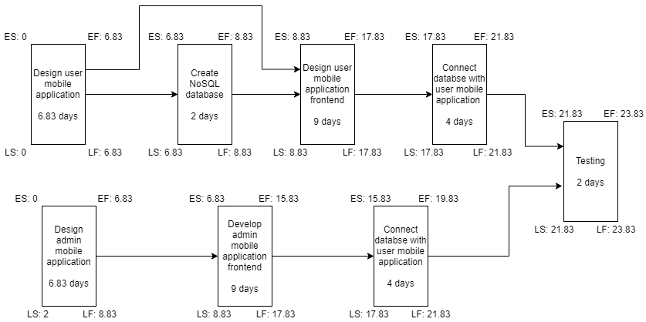
PERT Chart

Slide 16
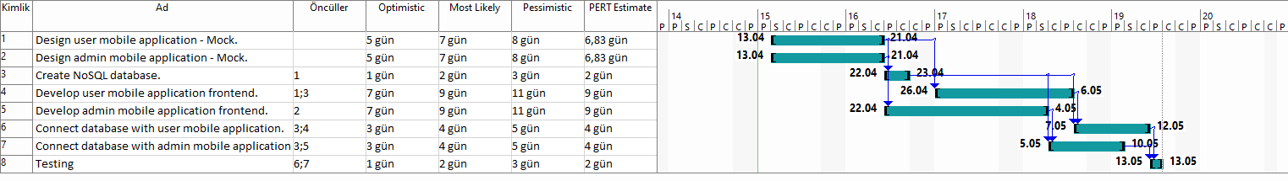
Gantt Chart

Slide 17
Staff
Design user mobile application - Mock.
Developer 1
Design admin mobile application - Mock.
Developer 2
Create NoSQL database.
Developer 1
Develop user mobile application frontend.
Developer 1
Develop admin mobile application frontend.
Developer 2
Connect database with user mobile application.
Developer 1
Connect database with admin mobile application.
Developer 2
Testing
Developer 1 and Developer 2

Slide 18
Control and Direct Project
Flutter for developing hybrid mobile and web applications.
Dart is needed because using the flutter framework requires coding language.
Firebase is to create our cloud database server which is free up to some limits.
Figma is to create our mockings of the screens.
Diagram drawing tools are needed to create our work plan, flow charts, maybe use cases etc.
Microsoft Project is to create work plans.
Draw.io is to create flow charts and use cases.

Slide 19
Control and Direct Project
The company already has profitable cash flow. Cost of the Park It app and technological infrastructure investment is affordable for the company. However if we want to hook new customers, we have to promote the app and the company. Advertising expenses can be very much from an affordable level of company.
Parking lots have great locations but the company promoting team is insufficient. We have to deal with an advertising company.
If everything is going bad and we lose lots of money, we can make deals with nearby malls, business centers to rent our parking lots.
For #4 and #5 parking lots, we can rent buildings for activities and entertainment. This can be a very good way to make profit from the buildings.

Slide 20
Analysis

Slide 21
TABLE OF CONTENTS
01
Analysis Strategy
04
Use Case Analysis
02
05
Requirements Elicitation Techniques
Data Flow Diagrams/Process Models
03
06
Requirements Definition
Data Model

Slide 22
Analysis Strategy
Business Process Automation
We basically automate the ticketing system of the parking lot company. Instead of using paper for the labeling entrance and exit times, we will be using a QR code system adapted to the parking lots.
This digitized information of entrance and exit times, allow us to process data and give some analysis of the day by day densities graph of the parking lots.
Also, we realized that companies fve parking lots are working independently. With our application, the company not only obtains its financial incomes but also centralizes their parking lots and becomes easier to control their five lots.

Slide 23
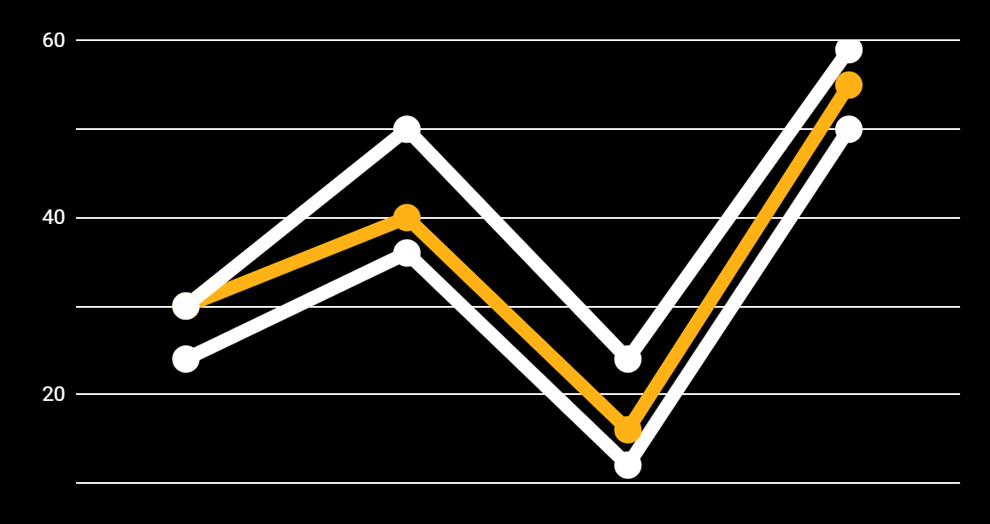
Analysis Strategy
Business Process Improvement
Company had problems advertising and managing. With our app, we will give a chance to control all their parking lots from one application. They can receive feedback from customers too. With this situation, the company becomes institutionalized.
Also, Since the company and the customers know the density information they are now allowed to find the best available parking lot instead of trying to find an empty parking lot by going one by one.

Slide 24
Analysis Strategy
Business Process Reengineering
Firstly the idea of Park It was making profit of park lots that not flagship ones, increase density of parking lots. However we realized that the company does not have capacity to manage five parking lots.
All parking lots are managed like they belong to different companies. Different rules, different prices, obvious differences in service quality etc. With our app, all lots work as one parking lot.
Also thanks to our feedback system, customers can give feedback about their experience in the parking lot. So that company will be able to respond to problems immediately.

Slide 25
Requirements Elicitation Techniques
We used interview elicitation technique. We asked couple of question with company authorities and made survey with customers.
Question 1: What kind of automation system you are using on your parking lots
Answer: We don't have any automation system. All parking lots using ticket based payment system but they don’t have any connection each other
Question 2: How many parking spaces do you have for each of the parking lots?
Answer: We have five parking lot facilities. two of them our main ones named flagship parking lots. Parking lot capacities are below:
#1: 100; #2: 200; #3: 300; #4: 300; #5: 400
Question 3: Are you keeping entrance and exit information of customers?
Answer: We just collect daily entrances of customers of parking lots and number of members.
Question 4: Do you have a certain pricing strategy for your parking lots ?
Answer: We don't have any strategy. We determine our prices according to opponent companies prices.

Slide 26
Survey we made with customers
 | Parking Capacity | Cleaning and behaviours of employees | PaymentSystem | Pricing Policy
#1 | 3 | 4 | 1 | 2
#2 | 2 | 5 | 2 | 3
#3 | 7 | 7 | 3 | 5
#4 | 8 | 3 | 2 | 6
#5 | 9 | 2 | 5 | 8
 | #1 | #2 | #3 | #4 | #5
Most of the time, parking lot is full | 9 | 8 | 3 | 1 | 2
Pricing policy is good. | 3 | 4 | 5 | 6 | 7
I would like to get membership from this company | 3 | 2 | 4 | 5 | 4
There is a queue at the exit due to parking payment | 10 | 9 | 7 | 4 | 2
 | #1 | #2 | #3 | #4 | #5
Company reserve enough free parking spaces for members | 1 | 2 | 10 | 10 | 10
Pricing policy is good | 2 | 4 | 6 | 7 | 6
I recommend your services to my friends | 1 | 1 | 4 | 5 | 4
I will extend my membership | 2 | 3 | 6 | 7 | 6

Slide 27
Feedbacks from Customers
Question 4: Do you have anything to add to the above survey.
Customer 1 from #1: I don't want to wait at the entrance and exit due to non-member customers.
Customer 2 from #1: Sometimes I can't enter the parking lot because the parking lot is over.
Customer 3 from #3: Parking officer taking more money from the price list.
Note: After this feedback, The company investigated this issue and realized that some of the parking officers defraud the company. This situation demonstrated how necessary a radical change in the payment system is.
Customer 4 from #5: Parking officers are very rude. I am not surprised why the whole parking lot is empty.
Customer 5 from #4: Even #3 is very near to #4, #4 membership price is 50$ expensive than #3.

Slide 28
Requirements Definition
01
Functional requirements
a
b
Information-oriented functional requirements
The application should collect data of the customer entrance and exit information for all time.
The application should have the real-time density information of the parking lots.
The application must include the information about the monthly memberships.
The application must include payment features.
Process-oriented functional requirements
The application must allow registered users to view their payment details for anytime.
The application must allow users to check in/out to the parking lot anytime with the QR code system.
The application must allow the users to make their payments online.
The application must show the density of each parking lot to customers and direct customers to parking lots have lower density

Slide 29
Requirements Definition
02
Nonfunctional requirements
a
b
Operational non-functional requirements
The system will be able to run on android and ios devices since we use the flutter framework to develop it.
Performance non-functional requirements
The application should be available for use all time.
The application should show the density of the parking lots live.
The check in/out QR system
The application should have easy interface

Slide 30
Requirements Definition
02
Nonfunctional requirements
c
d
Security non-functional requirements
The user information should not be leaked to the third parties.
The payments of all users should be seen by only managers of the company.
Cultural and political non-functional requirements
The application should be able to distinguish between Turkish currency and other currencies.
The billing of the parking lot payments should be at the same format of Turkish billing standards.

Slide 31
Use Case Analysis
Use case 1: Register
Description: The customers of the parking lot must register to the system with email and password.
Priority: High
Actor: The customers of the parking lot.
Trigger: Signup button.
Use case 3: View density of the parking lots live
Description: The customers and the managers of the parking lot company can monitor the density information of each parking lot.
Priority: Medium
Actor: The customers of the parking lot and the managers of the company.
Trigger: Live density tab of the application.
Use case 2: Login
Description: The customers and the managers of the parking lot company must login to the system with email and password.
Priority: High
Actor: The customers of the parking lot and the managers of the company.
Trigger: Login button

Slide 32
Use Case Analysis
Use case 4: Check in/out to the parking lot
Description: The customers of the parking lot company can enter or exit the parking lot with the QR code system.
Priority: High
Actor: The customers of the parking lot.
Trigger: QR code tab of the application.
Use case 6: See the payment details
Description: The managers of the parking lot company can view the payment details of all customers.
Priority: Medium
Actor: The managers of the parking lot.
Trigger: Payment history tab of the application.
Use case 5: See the payment details
Description: The customers of the parking lot company can view the payment details of his/her past service of parking.
Priority: Medium
Actor: The customers of the parking lot.
Trigger: Payment history tab of the application.

Slide 33
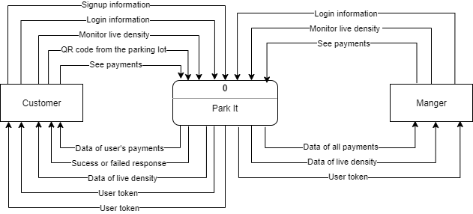
Data Flow Diagrams/Process Models
Context Diagram

Slide 34
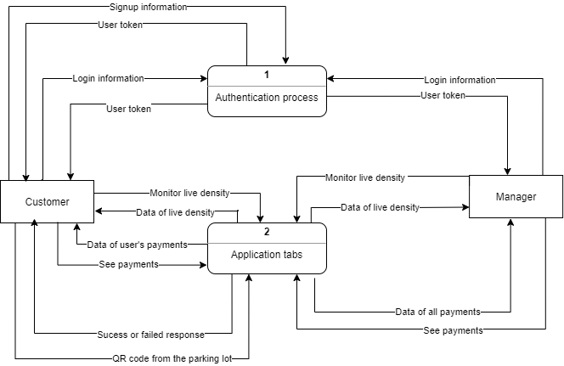
Data Flow Diagrams/Process Models
Level 0 DFD

Slide 35
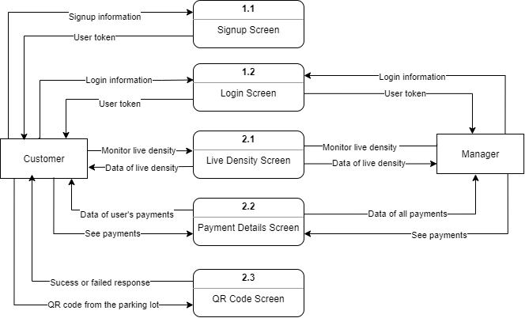
Data Flow Diagrams/Process Models
Level 1 DFD

Slide 36
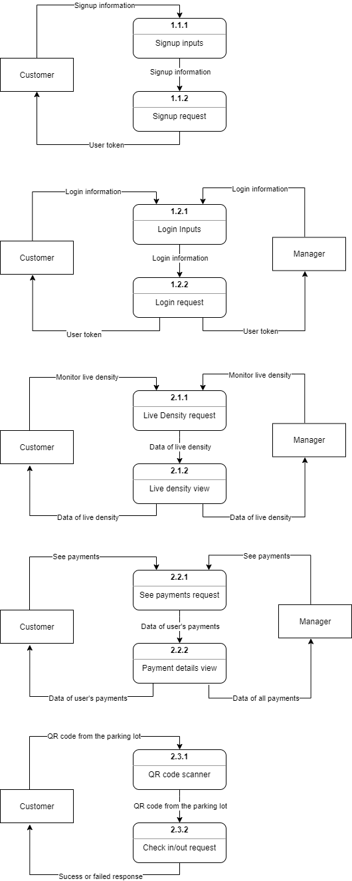
Data Flow Diagrams/Process Models
Level 2 DFD

Slide 37
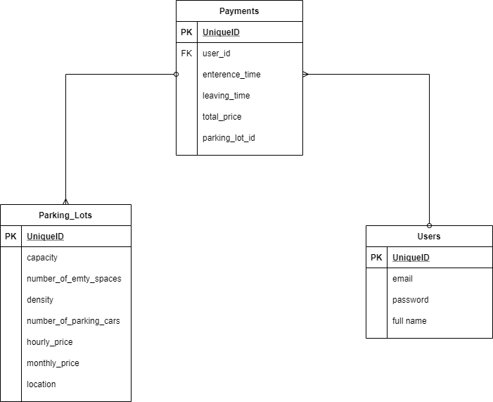
Data Model

Slide 38
THANK YOU FOR LISTENING!
ANY QUESTIONS?

